Slide 1
Proposed ABA Model Ethics Rule 8.4(g):
Threat or Menace?
Herb Grey
Herbert G. Grey, Attorney at Law
Laura Darien Nammo
Center for Law & Religious Freedom, Christian Legal Society
Notes:
When Kim starts speaking, wait 3 or 4 seconds then move to the next slide

Slide 2
WORKSHOP OVERVIEW
-The Model Rule:
What is it and what is it about?
-What’s the Big Deal, and Why Do We Care?
-Where are We in the States Currently?

Slide 3
Old Rule 8.4
It is professional misconduct for a lawyer to:
(d) engage in conduct that is prejudicial to the administration of justice . . . .

Slide 4
Old Rule 8.4 | Comment [3]
A lawyer who, in the course of representing a client, knowingly manifests by words or conduct, bias or prejudice based upon race, sex, religion, national origin, disability, age, sexual orientation or socioeconomic status, violates paragraph (d) when such actions are prejudicial to the administration of justice. Legitimate advocacy respecting the foregoing factors does not violate paragraph (d). A trial judge’s findings that peremptory challenges were exercised on a discriminatory basis does not alone establish a violation of this rule.

Slide 5
Old Rule 8.4 | Comment [3]
A lawyer who, in the course of representing a client, knowingly manifests by words or conduct, bias or prejudice based upon race, sex, religion, national origin, disability, age, sexual orientation or socioeconomic status, violates paragraph (d) when such actions are prejudicial to the administration of justice. Legitimate advocacy respecting the foregoing factors does not violate paragraph (d). A trial judge’s findings that peremptory challenges were exercised on a discriminatory basis does not alone establish a violation of this rule.

Slide 6
“Catch-all” provision
It is professional misconduct for a lawyer to:
(d) engage in conduct that is prejudicial to the administration of justice . . . .

Slide 7
ABA Rationale for Revising 8.4
1. Black Letter Rule v. Comment
2. Diversity & Anti-Discrimination Goals: SOGI Emphasis
3. For the “Public Good”
4. “Twenty-five jurisdictions have not waited for the ABA to act . . . .”
5. Alleged gender bias
6. Scope: “This [current] limitation fails to cover bias or prejudice in other professional capacities (including attorneys as advisors, counselors, and lobbyists) or other professional settings (such as law schools, corporate law departments, and employer-employee relationships within law firms). The comment also does not address harassment at all, even though the judicial rules do so.”

Slide 8
The Road to Amending Rule 8.4
May 2014 to Fall 2014 - Drafting begins
July 2015 – Draft released
July 2015 – February 2016 - Roundtables, Public Discussions, Hearings
August 2016 – adopted new rule, after major revisions based on objections of other ABA standing committees, but largely ignoring public comment and objections
Sponsors:
STANDING COMMITTEE ON ETHICS AND PROFESSIONAL RESPONSIBILITY
SECTION ON CIVIL RIGHTS AND SOCIAL JUSTICE
COMMISSION ON DISABILITY RIGHTS
DIVERSITY & INCLUSION 360 COMMISSION
COMMISSION ON RACIAL AND ETHNIC DIVERSITY IN THE PROFESSION
COMMISSION ON SEXUAL ORIENTATION AND GENDER IDENTITY
COMMISSION ON WOMEN IN THE PROFESSION

Slide 9
The Initial Response
494 Comments (17 of those in support . . . )
ABA Standing Committee on Professional Discipline Expresses its Concerns:
• “The Proposal Continues to Suffer from Vagueness That Raises Enforceability and Possible Constitutional Concerns.”
• "The Discipline Committee Supports Retention of the Mens Rea Requirement for Harassment and Discrimination.”
• “Categories of Individuals Not Yet Afforded Constitutional Protection [may] Raise Constitutional Concerns.”
• The “Proposed Model Rule 8.4(g) and Comment Do Not Adequately Address Other Issues, Including Lawyers’ Decisions to Decline a Representation.”
CLS Letter (March 2016)

Slide 10
August 2016 Revision
It is professional misconduct for a lawyer to:
(g) engage in conduct that the lawyer knows or reasonably should know is harassment or discrimination on the basis of race, sex, religion, national origin, ethnicity, disability, age, sexual orientation, gender identity, marital status or socioeconomic status in conduct related to the practice of law. This paragraph does not limit the ability of a lawyer to accept, decline or withdraw from a representation in accordance with Rule 1.16. This paragraph does not preclude legitimate advice or advocacy consistent with these Rules.

Slide 11
August 2016 Revision | Comments [3] – [4]
[3] Discrimination and harassment by lawyers in violation of paragraph (g) undermine confidence in the legal profession and the legal system. Such discrimination includes harmful verbal or physical conduct that manifests bias or prejudice towards others. Harassment includes sexual harassment and derogatory or demeaning verbal or physical conduct. Sexual harassment includes unwelcome sexual advances, requests for sexual favors, and other unwelcome verbal or physical conduct of a sexual nature. The substantive law of antidiscrimination and anti-harassment statutes and case law may guide application of paragraph (g).

Slide 12
August 2016 Revision | Comments [3] – [4]
[4] Conduct related to the practice of law includes representing clients; interacting with witnesses, coworkers, court personnel, lawyers and others while engaged in the practice of law; operating or managing a law firm or law practice; and participating in bar association, business or social activities in connection with the practice of law. Lawyers may engage in conduct undertaken to promote diversity and inclusion without violating this Rule by, for example, implementing initiatives aimed at recruiting, hiring, retaining and advancing diverse employees or sponsoring diverse law student organizations.

Slide 13
Major Changes
Moved from comment to text of the black letter Rule
“knowingly” v “reasonably should know
“Prejudicial to the Administration of Justice” no longer a limiting factor
Relationship to client representation and courtroom behavior no longer a limiting factor
“Related to the Practice of Law”
Addition of ethnicity, marital status, and gender identity
New focus on “harassment” and “discrimination,” not “bias and prejudice”

Slide 14
A Note on Declining or Withdrawing (1.7)
[A] lawyer shall not rep-resent a client if the representation involves a concurrent conflict of interest. A concurrent conflict of interest exists if
there is a significant risk that the representation of one or more clients will be materially limited by … a personal interest of the lawyer.

Slide 15
Threat or Menace?
Speech Code
Breadth - First Amendment Concerns
Boards of Religious Organizations
Membership in Organizations that Engage in Speech
Viewpoint Discrimination
Legitimate Advice & Advocacy “consistent with these rules”

Slide 16
Threat or Menace?
ABA Model Rule 8.4(g) is significantly broader than the various pre-existing anti-bias rules in 24 states.

Slide 17
Broader than Pre-existing Anti-Bias Rules
Several states’ rules apply only to unlawful discrimination that has been adjudicated by a non-bar tribunal before misconduct charge can be initiated.
Many states’ rules limited to “conduct in the course of representing a client.”
Many states require that the misconduct be “prejudicial to the administration of justice.”
Almost no state enumerates all eleven of the protected classifications.
No state has the circular “protection” for “legitimate advocacy . . . consistent with these rules.”

Slide 18
Threat or Menace?
Proponents make two contradictory arguments: This rule is desperately needed, and it must have broad scope, but it is really a symbolic statement that will be little used.

Slide 19
Threat or Menace?
ABA Model Rule 8.4(g) is a speech code for lawyers that will chill the exercise of lawyers’ First Amendment Rights.

Slide 20
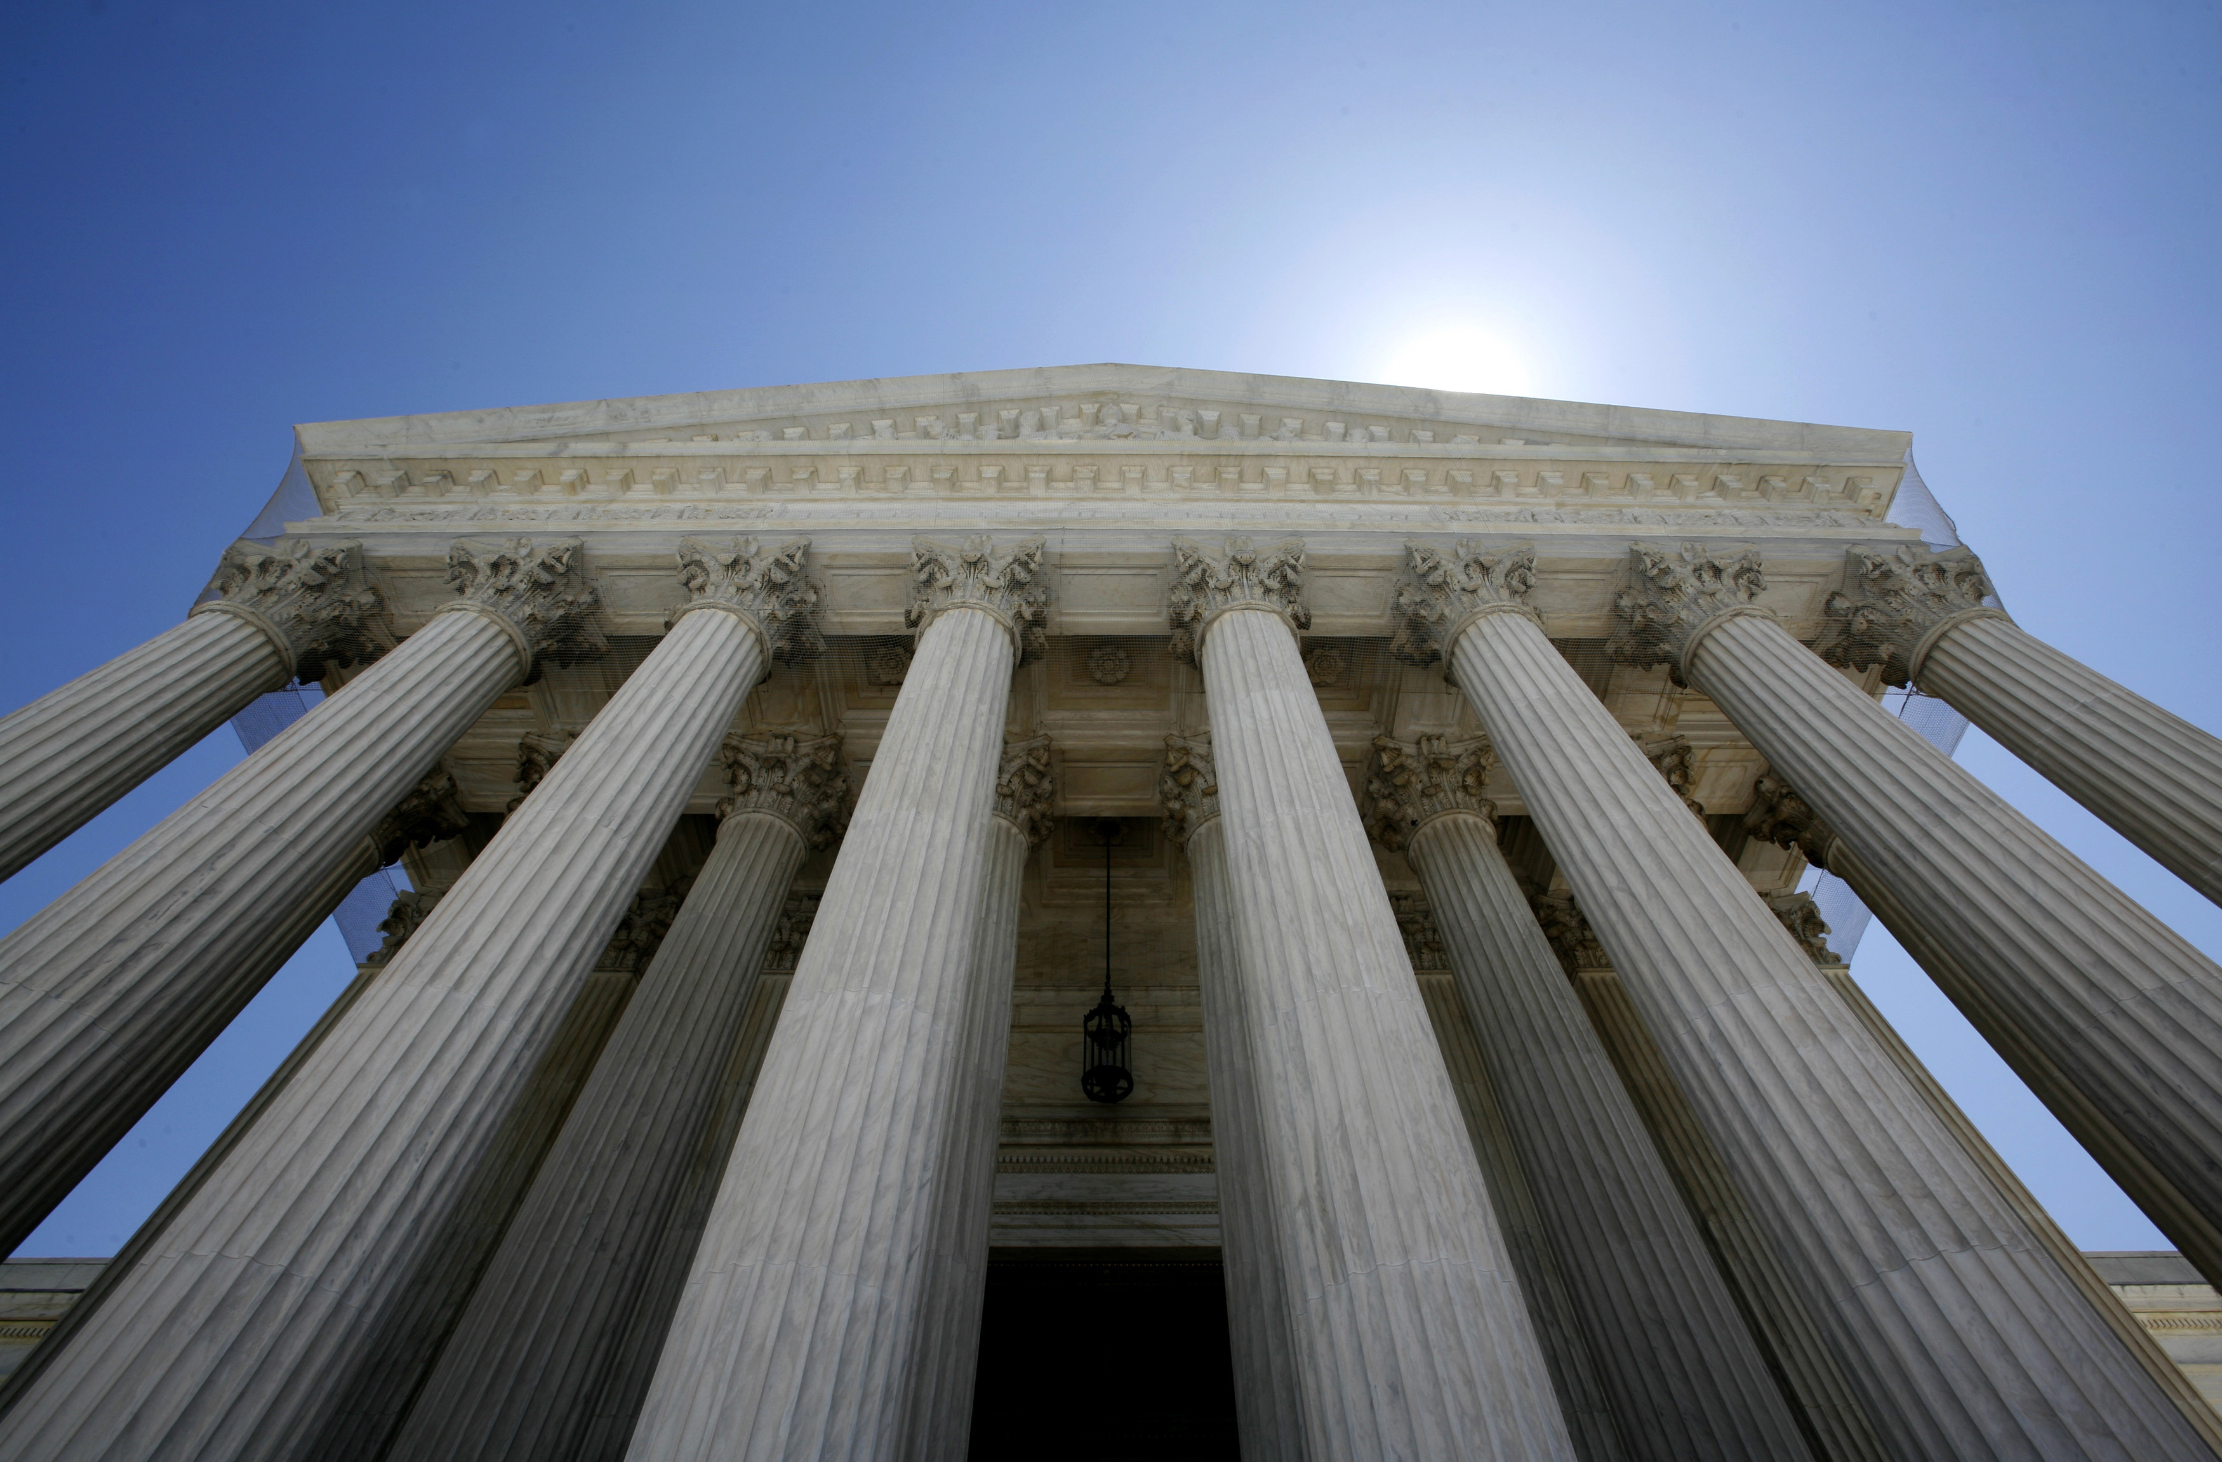
Speech Code & Chilling Effect
Two Recent Supreme Court Cases:
National Institute of Family and Life Advocates v. Becerra, 138 S. Ct. 2361 (2018) Government restrictions on professional speech are subject to strict scrutiny.
Matal v. Tam,
137 S. Ct. 1744 (2017)
Statute that authorizes government to penalize “disparaging” speech is facially unconstitutional.

Slide 21
Speech Code & Chilling Effect
-ABA Model Rule 8.4(g) is facially viewpoint discriminatory
-ABA Model Rule 8.4(g) is also viewpoint discriminatory in that it allows the government to determine what is and is not “legitimate advice and advocacy.”
-ABA Model Rule 8.4(g) encompasses nearly everything a lawyer does

Slide 22
Threat or Menace?
ABA Model Rule 8.4(g) threatens attorneys’ religious freedom.

Slide 23
Religious Freedom Issues
Attorneys could be subject to discipline for volunteer legal work on boards of their churches, religious schools and colleges, or other religious ministries.
Attorneys’ membership in religious organizations that choose their members or leaders based on religious beliefs may be subject to discipline as “religious discrimination.”

Slide 24
Threat or Menace?
State Bar Disciplinary Counsel will become “courts” of first resort for employment and other discrimination claims in law offices and bar events

Slide 25
Efforts in the States: Update
States that have rejected or abandoned adoption efforts:
Texas–AG opinion 13
South Carolina–House of Delegates; AG opinion; Supreme Court order
Montana–Legislature joint resolution
Illinois–House of Delegates vote; comment period; but new effort to adopt
Louisiana–AG and District Attorneys opposed; rules committee voted not to proceed.
Nevada–State bar petition withdrawn
Tennessee–AG opinion; Supreme Court order
Arizona–Supreme Court order
Idaho–Supreme Court order
Minnesota–ABA reports Minnesota rejected
North Dakota–rules committee refused to recommend
Colorado–subcommittee tabled consideration
South Dakota
Wisconsin
Utah
Hawaii
States that have fully Adopted 8.4(g):
Vermont
New Mexico
States that have adopted significantly narrower versions:
Alaska
Maine
Colorado
Connecticut
Pennsylvania
New Hampshire
Hawaii
California?

Slide 26
Efforts in the States: Update
Oregon
Idaho
Wisconsin
Pennsylvania
Others?

Slide 27
States Now Face a Choice . . .
Where do we stand on opposition to Rule 8.4 and where should we go from here?

Slide 28
Some Hypotheticals

Slide 29
Hypothetical 1
Lenny Lawyer says, “I abhor the idle rich. That guy makes me sick.”
In which of the following contexts might Lenny be subject to discipline under the New Model 8.4(g)?

Slide 30
Hypothetical 1
Lenny is speaking at a firm’s hiring committee meeting, considering an applicant for a summer clerk, to whom he is referring.

Slide 31
Hypothetical 1
Lenny is speaking with opposing counsel in a case, referring to one of the parties, who overhears him.

Slide 32
Hypothetical 1
Lenny is on a CLE panel, arguing for the elimination of the capital gains tax, and he says it as a joke.

Slide 33
Hypothetical 2
Lori Lawyer is approached by a homosexual couple who want her to represent them in adopting a child. Lori refuses.
Is she subject to discipline under ABA Rule 8.4 under any of the following circumstances?

Slide 34
Hypothetical 2
She is too busy to give it proper care and attention and says so.

Slide 35
Hypothetical 2
She was raised by lesbians and had a terrible childhood. She tells them she would do a terrible job, due to her past experience with homosexual parents.
They are offended by this.

Slide 36
Hypothetical 2
She feels it would violate her conscience, since she thinks their lifestyle would be a harmful environment in which to raise a child, and she tells them so in declining.

Slide 37
What can you do?
Monitor your state activity!
Become an active participant in local and state bar activities!

Slide 38
Questions? Email:
Laura@clsnet.org

Slide 39
Resources
www.clsnet.org
Click on the ABA 8.4(g) box at the bottom, where you will find resources and more information including:
ABA 8.4(g) Pitfalls Memo
CLS Letters to the ABA and State Ethics Authorities
Questions:
laura@clsnet.org
Notes:
KIM:
A few housekeeping items before we get started.
We are going to cover a lot of material during this webinar.
WE HAVE NOT SUBMITTED THIS WEBINAR FOR CLE APPROVAL IN ANY STATE. However, we are happy to provide you with the materials you would need to submit it for credit on your own.
We have posted much of the information to be discussed, including our letter to the ABA, and our various letters to some of the states, on the Christian Legal Society website. Just go to the CLS homepage at www.clsnet.org, click on the box that says: ABA Rule 8.4 – and you should be able to find everything.
If you have any questions for our panelists now or later, email us at clshq@clsnet.org. And if you are having technical difficulties, please email webinar@ecfa.org.
I am very pleased to introduce our expert panelist.
CUE for NEXT SLIDE: I am very pleased to introduce our expert panelist
[NEXT SLIDE]

Slide 40
New Ethics Rule 8.4(g):
Threat or Menace?

