Slide 1
Medicaid Planning Opportunities, Challenges, and Pitfalls
Resource Assessment: Annuitizing the Spend Down
By John Laboe, Esq.

Slide 2
Married Couple

Slide 3
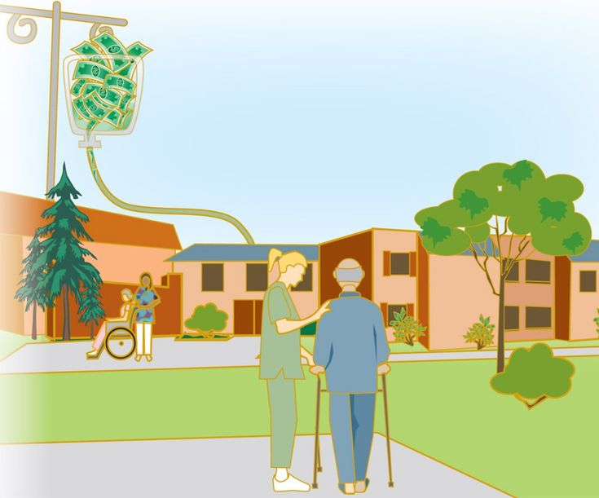

Slide 4
Nursing Home
Spouse has life event and requires long term care
Spouse is permanently placed in nursing home.

Slide 5
At home Spouse
Retained assets (non-countable assets)
Home & contents
Family Car
Note: although not considered a “countable asset” per se, at- home spouse can retain Unlimited Income.

Slide 6
Combined Marital Assets
For illustration purposes, Robert has $140,000 of assets in his name and Barbara has $210,000. The couple’s combined countable assets are $350,000.

Slide 7
State’s view of assets available for “Private Payment” of costs of nursing home, subject to calculation of spousal resource allowance.

Slide 8
Allocation of countable assets and determination of spousal resource allowance
Each spouse is deemed to have one half of the combined assets.
This is completely without regard to any pre- or post-marital agreements between the marriage partners.
However, the at home spouse may not retain an amount greater than $148,620. Any amount in excess of that is deemed subject to consumption for spend down.
Therefore, the exempt assets are the institutionalized spouse’s allowed $2,500 and the at-home spouse’s $148,620.
The difference leaves a required spend down amount of $198,880.

Slide 9
Step 1 is always to dedicate the spend down amount on things that the at home spouse needs or ought to expend for.
Step 2 in consuming the spend down will be the purchase of a Medicaid qualified annuity with the at home spouse being the annuitant.
There is no maximum limit to the dollar value of the annuity.
Alternatively, the spend down could be consumed by the purchase of income producing real estate owned by the at home spouse.

Slide 10
Medicaid Qualified Annuity
Features
Spend down funds are converted to non-countable asset
Payable exclusively to at-home spouse
Payout period at or less than life expectancy
Death benefit (if any) goes to State to reimburse Medicaid paid care costs of unhealthy spouse

Slide 11
At Home Spouse
Retained assets (non-countable assets)
Home & contents
Family Car
Note: although not considered a “countable asset” per se, at- home spouse can retain Unlimited Income.
Monthly annuity payments received
Use and status of funds not disclosed to State
Unless or until at-home spouse is institutionalized later and must private pay for his/her Long Term Care

