Slide 1

Considerations in Pro Se Assistance & Pro Bono Representation

Slide 2
Course Outline (Hour 1)
Assisting Pro Se Litigants
  Defining & Understanding “Pro Se”
  Pro Se Assistance & Ltd. Scope Representation
  UPL for Unrepresented/Pro Se Litigants
  Addressing Barriers to Pro Se Litigants
  Pro Se Forms & Resources
  Coaching for Pro Se Court Appearances
  Q&A/Discussion Questions

Slide 3
Course Outline (Hour 2)
Encouraging Pro Bono Representation
  Establishing Need for Pro Bono Services
  Benefits for Pro Bono Practitioners
  Barriers for Pro Bono Representation
  Opportunities for Pro Bono Assistance
  Low-Bono Representation
  Q&A/Discussion Questions

Slide 4
Justifying Pro Se Assistance
“Pro Se” – Latin for “on one’s own behalf”
Increase in Pro Se Litigants
  In Family Law cases, 67% of filings in CA, 73% in FL, 70% in WI (1)
  In more than 70% of civil cases, families are going to court alone (2)
Old adage: “One who is his own lawyer has a fool for a client.”
“Forcing a lawyer upon an unwilling defendant is contrary to his basic right to defend himself.” (Faretta v. California) (3)
“Defendants should be made aware of the dangers and disadvantages of self-representation so that … he knows what he is doing and his choice is made with his eyes open” (4)
(1) Madelynn Herman (September 25, 2006). "Self-Representation: Pro Se Statistics". National Center for State Courts. Archived from the original on 2012-05-04.
(2) http://connecticutlawreview.org/files/2015/01/9-Steinberg.pdf
(3) Faretta v. California, 422 U.S. 806 (1975)
(4) Id.

Slide 5
Constitutional Basis for Pro Se Representation
Faretta vs. California recognizes the right to represent oneself
  "[i]n the federal courts, the right of self-representation has been protected by statute since the beginnings of our Nation. Section 35 of the Judiciary Act of 1789, 1 Stat. 73, 92, enacted by the First Congress and signed by President Washington one day before the Sixth Amendment was proposed, provided that 'in all the courts of the United States, the parties may plead and manage their own causes personally or by the assistance of counsel.’”
Limitations to Right to Self-Representation
  McKaskle v. Wiggins – Court may appoint standby counsel over pro se defendant’s objection
  Martinez v. Court of Appeals of CA – No constitutional right to be pro se during criminal appeals
  Indiana v. Edwards – Questions modern relevancy of Faretta with the increased availability of attorneys
  Other Limitations: Disruptive behavior, Use for Delay, Untimely, Hybrid Representation, Representing Corporations
McKaskle v. Wiggins, 465 U.S. 168 (1984).
Martinez v. Court of Appeals of Cal., 528 U.S. 152 (2000).
Indiana v. Edwards, 554 U.S. 164 (2008).

Slide 6
Why Pro Se?
University of MD Law School Study:
  57% - Could not afford an attorney
  18% - Did not want to spend the money
  21% - Believed their case was simple and they didn’t need an attorney
45% of pro se litigants believe lawyers are “more concerned with their own self promotion than their client’s best interest” – ABA Legal Needs Study
Community Access to Justice
  Limited access to counsel
  Access to limited counsel

Slide 7
Pro Se Assistance &
Limited Scope Representation
Legal advice has the following characteristics:
  Requires legal knowledge, skill, education, and judgment
  Applies specific law to a particular set of circumstances
  Affects someone’s legal rights or responsibilities
  Creates rights and responsibilities in the advice-giver
    Land Title Abstract & Trust Co. v. Dworken, 193 N.E. 650 (1934)
“… If a pleading is prepared in any substantial part by a member of the bar, it must be signed by that attorney to avoid misrepresentation.” – Ostevoll w. Ostevoll, 2000 WL 1611123 (S.D. Ohio)

Slide 8
Ohio Rules of Professional Conduct & Limited Scope Representation
Rule 1.2 – A lawyer may limit the scope of … representation if the limitation is reasonable under the circumstances and communicated to the client, preferably in writing.
  An agreement between the lawyer and the client regarding the scope of the representation may limit the matters for which the lawyer is responsible. … Although [agreement] does not exempt a lawyer from the duty to provide competent representation, the limitation is a factor to be considered when determining the legal knowledge, skill, thoroughness, and preparation reasonably necessary for the representation.
  Task force recommends clarification term “reasonable under the circumstances”
  Practical application – is this reasonable?
Rule 4.3 - Dealing with Unrepresented Parties
Rule 6.5 – Lawyers who, with a nonprofit organization, provide short-term limited legal services not expected to continue are subject to:
  Rules 1.7 & 1.9 (a) – If conflict of interest is known
  Rule 1.10 if lawyer knows another lawyer in the same firm is disqualified by 1.7/1.9(a)

Slide 9
Unauthorized Practice of Law by and for Pro Se Litigants
ORC 4705.07 Unauthorized practice.
(A) No person who is not licensed to practice law in this state shall do any of the following:
(1) Hold that person out in any manner as an attorney at law;
(2) Represent that person orally or in writing, directly or indirectly, as being authorized to practice law;
(3) Commit any act that is prohibited by the supreme court as being the unauthorized practice of law.

Slide 10
Unauthorized Practice of Law for Pro Se/Unrepresented Litigants
Prohibits non-attorneys from providing legal advice, preparing legal papers or pleadings, charging fees, carrying out legal proceedings in court
LCBA v. Zubaidah
  Not UPL: Community activism, character/reference letter, nonlegal advice
  UPL: Signing formal agreements, presentation of legal arguments in court
CBA v. Henley – Advising of legal rights and terms/conditions of settlement
Disclaimers, good intentions, or free services do not excuse UPL
Examples
  Friends/Family Members drafting pleadings or providing court representation
  Notarios
  Community Activists providing representation
  Clinic volunteers/paralegals/law students
Lorain Cty. Bar Assn. v. Zubaidah, 140 Ohio St. 3d 495, 496 (2014).
Cleveland Bar Assn. v. Henley, 766 N.E.2d 130 (2002).

Slide 11
Barriers to Pro Se Litigants – Success Rates
Those represented by an attorney before administrative agencies (SSI, immigration, unemployment) have up to 2-3 times more success than those unrepresented by counsel
74% of non-detained immigrants with counsel prevailed in their cases, as compared to 13% of those without counsel
Discuss: What are some potential barriers to success for pro se litigants?

Slide 12
Barriers to Pro Se Litigants
Lack of knowledge of law
Lack of knowledge of procedure
Literacy/education/technology limitations
Effective Communication
Language limitations
Disability limitations
Transportation
Decorum/Presentation

Slide 13
Barriers to Pro Se Litigants – Addressing Limitations
Lack of legal/procedural knowledge
  Pro Se Offices/Assistance
  Juvenile Justice Center– Pro Se Offices - 216-443-3149; 9300 Quincy Ave. 2nd floor Walk-in Hours – 9am-1pm; 2pm-4pm Monday-Friday
  Domestic Relations Information Center - 1 W. Lakeside Ave., Room 306, Cleveland, OH 44113
  Housing Court – Escrow/Mediation by request - 1200 Ontario St., Room 13B, Cleveland, OH 44113; (216) 664-4295
  Small Claims – Video and Brochure available for Cleveland Municipal Court
  Cleveland Mediation Center - 2012 W 25th St #412, Cleveland, OH 44113
  Neighbor disputes, LL/Tenant, visitation/custody, divorce/ dissolution, bullying, school/student/parent concerns

Slide 14
Barriers to Pro Se Litigants – Addressing Limitations
Procedural Limitations
  Filing Fees
    Poverty Affidavits/Affidavits of Indigency
      Income, Expenses, Family Size
      Some courts will defer filing fees instead of waiving
  Service
    Who to serve
    How to serve
  Standing - Are they the right party? Are they litigating against the right party?
  Managing Deadlines
  Transportation/Access

Slide 15
Barriers to Pro Se Litigants – Effective Communication with Assisting Attorney
Client-focus vs. Attorney-focus
  Who makes decisions? How are plans created?
Empathy vs. Sympathy
  Are you feeling with or for the client? Are you hearing what the incident means to them or what it would mean to you?
Non-Judgmental vs. Judgmental Language
  “Help me understand” vs. “That makes no sense”
  “The law requires/the judge will look for..” vs. “That won’t work”
  “Yes, and…” vs. “Yes, but…”
Consider:
  Race, Culture, SES, Domestic Violence Victims, Mental Illness, Substance abuse, Criminal Records
Do’s and Don’ts of Interviewing Low-Income Clients. Jaime Moore, JD, Andrya Soprych, LCSW. Christian Legal Society Conference, October 2015

Slide 16
Barriers to Pro Se Litigants – Language
  27 court forms available in five major languages: Arabic, Chinese, Russian, Somali, and Spanish. You must still complete and file the English version of these translated forms. Available at http://www.supremecourt.ohio.gov/JCS/interpreterSvcs/forms/ (Guardianship; Criminal; Protection Order; Small Claims)
  Must still complete English versions
  Request an interpreter - call 1.888.317.3177, M-F, 8 AM to 5 PM
  Courts encouraged to provide interpretation services where they protect a person’s rights
  The court interpreter is a neutral party who only interprets the proceedings and facilitates communication
  If a pro se litigant is denied access to an interpreter, you can initiate a complaint by calling the Supreme Court of Ohio Language Services Program at 1.888.317.3177

Slide 17
Barriers to Pro Se Litigants – Disability
Disability Limitations
  Courtroom accessibility
    ASL, Service Dogs, Addressing Witnesses, Microphones
  http://disabilityjustice.org/courtroom-access-and-accommodations/
  Supreme Court of Ohio Bench Card 2.0 – Working with Interpreters for Deaf & Hard of Hearing Persons in the Courtroomhttp://www.sconet.state.oh.us/publications/interpreter_services/DeafHOHbenchcard.pdf

Slide 18
Forms & Resources for Pro Se Litigants & Pro Bono Attorneys
Pro Se Offices
  Forms & Assistance, Procedural Information
Legal Aid Resource Center - https://lasclev.org/resources/overview/
  Topical brochures covering substantive law & procedure
Ohio Legal Services - http://www.ohiolegalservices.org
  Substantive Law, Procedure, Tips for Pro Se Litigants
Keys to the Courtroom – OSBF - http://www.fcmcclerk.com/resources/pdf/KeysBrochure2.pdf
  Procedure, Terminology, Finding Substantive Law
Ohio Supreme Court Guide for Pro Se Litigants - http://www.supremecourt.ohio.gov/Publications/filingGuide.pdf
  Common mistakes, Terminology, etc.
Cleveland Law Library - http://clevelandlawlibrary.org/
  Legal research, forms, etc.

Slide 19
Forms & Resources for Pro Se Litigants
Area-of-Law Specific Resources
  Cleveland Tenants Organization (Landlord/Tenant) - http://www.clevelandtenants.org/
  Housing Research & Advocacy Center (Housing Discrimination) - http://www.thehousingcenter.org/
  NHS Consumer Law Center (Credit/Debt, Consumer Law) - http://www.nhsconsumerlawcenter.org/
  Reentry Coalition (Record Sealing/CQE) - www.reentrycoalition.ohio.gov
  Pro Seniors (Elder Law, Medicare/Medicaid, Consumer Law, Housing Law)
  http://www.proseniors.org/

Slide 20
Coaching for Court Appearances
Decorum/Presentation
  Timeliness
  Attire
  Phones
  Children & family
Respectful Language
  Addressing judge/magistrate and relevant parties
  Speaking in turn
  Emotional Composure
Relevance
  Timeline
  Relevant Parties
  Relevant Issues and Events
  Specifics
  Facts, not judgments

Slide 21
Questions for Discussion
What are some barriers you’ve seen pro se litigants encounter? How did you assist them in getting through the barrier?
Where do you draw the line between assisting a pro se litigant and providing representation?
What hinders you from assisting a pro se litigant?
What resources or tips have you used to assist pro se litigants?

Slide 22
Encouraging Pro Bono Representation
Encouraging Pro Bono Representation
  Establishing Need for Pro Bono Services
  Benefits for Pro Bono Practitioners
  Barriers for Pro Bono Representation
  Opportunities for Pro Bono Assistance
  Low-Bono Representation
  Q&A/Discussion Questions

Slide 23
Establishing Need - Evaluating the Justice Gap
At least 40% of low and moderate-income households experience a legal problem each year.
Only about one in five low-income Americans get the free legal help for which they are eligible.
The foundation reported disbursing nearly $30.8 million in 2008, compared with $16.2 million in 2013 to Ohio's six legal aid societies.
In 2013, Eligibility grew from 50.8 million to 65.5 million nationwide
Ison, J. (2014, September 22), “Legal help shrinking for those in poverty.”http://www.ablelaw.org/media-room/news-and-press-releases/2014-news-archive/3279-legal-help-shrinking-for-those-in-poverty

Slide 24
Establishing Need
“Programs funded by the LSC (Legal Services Corporation) helped approximately 2.3 million people in America in 2011 — but turned away perhaps as many as 50 percent of the folks who asked for such legal help. According to recent Census Bureau statistics, one in five Americans — roughly 60 million people — qualify for legal assistance in their civil conflicts.”
How the Sequester Will Take Its Toll on Access to Justice, Andrew Cohen.

Slide 25
Establishing Need
“It is estimated that one-half of all low-income households have at least one serious legal problem each year, but three-quarters have no access to a lawyer. Studies conducted by the American Bar Association and other legal services and bar associations indicate that the current level of pro bono services is meeting 20% of the legal needs of the poor.”
Report to the President of the United States on the Status of People of Color and Pro Bono Services in the Legal Profession. http://www.lfoa.org/barnone/barnone_collaboration.html#numbersc
“According to the most recent national survey of the American public, ‘only 14% of civil justice problems were taken to a court or hearing body.’”
Civil Legal Needs and Public Legal Understanding. http://www.americanbarfoundation.org/uploads/cms/documents/sandefur_-_civil_legal_needs_and_public_legal_understanding_handout.pdf

Slide 26
Establishing Need
Access to counsel has helped decrease the number of victims of relationship abuse by as much as 21%
  Access to Justice for Victims of Domestic Violence Project. http://www.justice.gov/sites/default/files/atj/legacy/2011/01/31/dv-pipeline-project-web-fact-sheet.pdf
Represented parties have 2-3x higher success rates in administrative hearings
  Amy Myrick, Robert L. Nelson & Laura Beth Nielson, Race and Representation: Racial Disparities in Legal Representation for Employment Civil Rights Plaintiffs, 15 N.Y.U. J. LEGIS. & PUB. POL’Y 705, 710 (2012).
Represented parties have 74% higher success rates in non-detained immigration cases as compared to 13% success for unrepresented parties
  N.Y. Immigrant Representation Study Report, Accessing Justice: The Availability and Adequacy of Counsel in Removal Proceedings, 33 CARDOZO L. REV. 357, 363‐64 (2011).

Slide 27
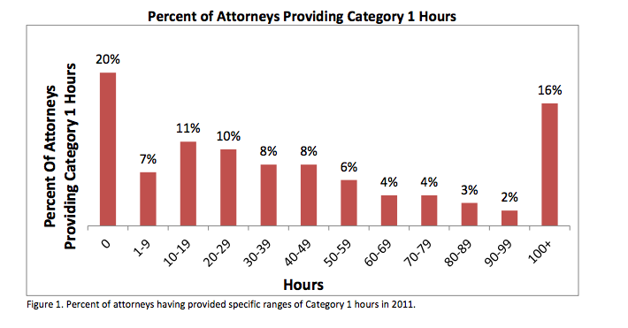
Establishing Need
  In 2011, % of attorneys providing free legal services to person of limited means or orgs. that do so (full case, ltd. scope, legal advice, or representation in mediation)
http://www.americanbar.org/content/dam/aba/administrative/probono_public_service/ls_pb_Supporting_Justice_III_final.authcheckdam.pdf

Slide 28
Benefits for Pro Bono Practitioners
Discuss some potential benefits for pro bono practitioners.
What motivates you to serve a pro bono client?

Slide 29
Benefits for Pro Bono Practitioners
Experience
  Subject matter
  Hands-on training
  Client interaction
Contribution to Public Good
Following Ethical Rules
Reputation of Lawyer & Firm
Personal, Interpersonal, or Spiritual Growth
CLE Incentives

Slide 30
Benefits for Pro Bono Practitioners
“For a lot of first-, second-, and third-year associates, one key thing that pro bono offers is relief from the stunning tedium of their paying work: relief from endless hours of discovery and 'due diligence,' from the mind-numbing frustration of researching codes and producing the first drafts of motions, oppositions, answers, briefs, memos, replies, and surreplies. It offers the chance to have a live, red-blooded client, a ‘real person’ with real problems.”
Liza Mundy, “The Pro Bono Hustle,” Washington Monthly, Sept. 1989 at 12.

Slide 31
Benefits for Pro Bono Practitioners
Provides hands-on experience for new associates (interviewing, questioning witnesses, appearing in court)
Builds relationships between firm partners and local community agencies
Improves morale firm-wide, enhances firm reputation, strengthens ability to attract new clients
http://www.law.harvard.edu/current/careers/opia/toolkit/guides/documents/guide-pro-bono.pdf

Slide 32
Benefits for Pro Bono Practitioners
“A lawyer will gain large satisfaction when he or she is not simply a fee-charging artisan, but a contributor to the public good.” -Ruth Bader Ginsburg, Supreme Court Justice
“Pro bono work is a win-win for the firm. We have the opportunity to provide legal services to those in our community most desperately in need, and our attorneys get hands-on experience on a variety of significant legal matters.” Steven Schulman, National Pro Bono Counsel for the firm of Latham and Watkins

Slide 33
Benefits for Pro Bono Practitioners – Ethical Rules
Model Rule 6.1 - “a lawyer should aspire to render at least fifty (50) hours of pro bono public legal services per year.”
  Supreme Court of Ohio has deferred consideration on this issue
Ohio Rules of Professional Conduct Rule 6.2 - ACCEPTING APPOINTMENTS - A lawyer shall not seek to avoid appointment by a court to represent a person except for good cause, such as either of the following:(a) representing the client is likely to result in violation of the Ohio Rules of Professional Conduct or other law; (b) representing the client is likely to result in an unreasonable financial burden on the lawyer.

Slide 34
Benefits for Pro Bono Practitioners – Ethical Rules
Ohio Rule 6.2 Comment [1] – All lawyers have a responsibility to assist in providing pro bono publico service. An individual lawyer fulfills this responsibility by accepting a fair share of unpopular matters or indigent or unpopular clients.

Slide 35
Benefits for Pro Bono Practitioners – New CLE Rules
Effective January 1, 2014, attorneys may receive one credit hour of continuing legal education for every six hours of pro bono legal service they perform, up to a maximum of six hours for service performed during a biennial compliance period.
For purposes of receiving continuing legal education credit, “pro bono” means legal service provided by an attorney to either a person of limited means or a charitable organization in which the legal service is assigned, verified, and reported to the Commission by an organization recognized by the Commission.
Must be done through a pro bono sponsor
https://www.supremecourt.ohio.gov/AttySvcs/CLE/proBono/

Slide 36
Benefits to Pro Bono Practitioners – When to Take the Case
Nature of the Problem
Familiarity with Client
Familiarity with Referral Source
Expected Duration of Case
Expected Involvement in Case
Assistance of other counsel
Expected CLE Credit
Other considerations?

Slide 37
Barriers to Pro Bono Practitioners
List some barriers to pro bono practitioners both in accepting and in undergoing pro bono representation.

Slide 38
Barriers to Pro Bono Practitioners
Outside Normal Practice Area
  Malpractice/Ethical Considerations
  Contractual Issues
Communication with Low-Income Clients
Duration Concerns/Making Time
Access to clients in need

Slide 39
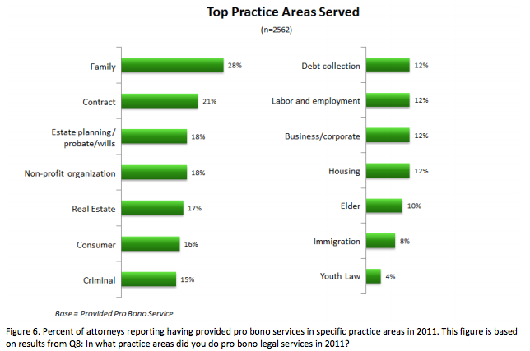
Barriers to Pro Bono Practitioners – Practice Area
http://www.americanbar.org/content/dam/aba/administrative/probono_public_service/ls_pb_Supporting_Justice_III_final.authcheckdam.pdf

Slide 40
Barriers to Pro Bono Practitioners – Practice Area
Ohio Rules of Professional Conduct
RULE 1.1: COMPETENCE
A lawyer shall provide competent representation to a client. Competent representation requires the legal knowledge, skill, thoroughness, and preparation reasonably necessary for the representation.
Comment [2] - A lawyer need not necessarily have special training or prior experience to handle legal problems of a type with which the lawyer is unfamiliar. A newly admitted lawyer can be as competent as a practitioner with long experience.

Slide 41
Barriers to Pro Bono Practitioners – Practice Area
Comment [2] … . . A lawyer can provide adequate representation in a wholly novel field through necessary study. Competent representation can also be provided through the association of a lawyer of established competence in the field in question.
Comment [4] A lawyer may accept representation where the requisite level of competence can be achieved through study and investigation, as long as such additional work would not result in unreasonable delay or expense to the client.

Slide 42
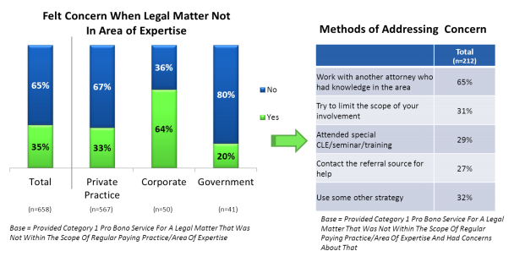
Barriers to Pro Bono Practitioners – Practice Area
http://www.americanbar.org/content/dam/aba/administrative/probono_public_service/ls_pb_Supporting_Justice_III_final.authcheckdam.pdf

Slide 43
Barriers to Pro Bono Practitioners – Contractual Issues
Pro Bono Representation Agreements
  May Limit Scope, but must be reasonable and in writing (Ohio Rule of Professional Conduct 1.2 (c))
  May require client to pay filing fees or court costs or not
  Require client to inform counsel of change of number, address, etc.
  Indicate if counsel does not carry professional liability insurance for the matter under Ohio Rule of Professional Conduct 1.4(c)(1)
  Do not contract to limit liability

Slide 44
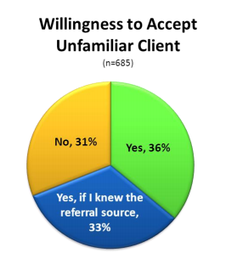
Barriers to Pro Bono Practitioners – Familiarity with Client
http://www.americanbar.org/content/dam/aba/administrative/probono_public_service/ls_pb_Supporting_Justice_III_final.authcheckdam.pdf

Slide 45
Barriers to Pro Bono Practitioners - Time Concerns &
Client Communication
Limit the scope of representation
Tell your clinic/legal aid organization your time constraints so they know how/when to refer
See “Do’s and Don’ts of Interviewing Low Income Clients” for suggestions on how to communicate effectively with clients

Slide 46
Opportunities for Pro Bono Representation
Legal Aid Societies & Bar Associations
  Scranton Road Legal Clinic
  Legal Aid Society of Cleveland
  Community Legal Aid
  CMBA
  Pro Seniors
  Volunteer Lawyers for the Arts
Firm Referrals
Friends, Family, Neighbors, Church Members, etc. in need (*can only get CLE credit if through org. providing pro bono services)

Slide 47
Low-Bono Representation
“We cannot continue to ignore the millions upon millions of people... throughout this nation who are almost poor, who do not qualify for legal aid, and who, in reality, are without sufficient funds to hire an attorney. -Gary G. Bellow, 1968
Alternative to mandatory pro bono service
Reduced hourly rate, capping cost of representation, or deferred cost
Income guidelines based on family size
Undervaluing legal representation or addressing the current state of legal services?

Slide 48
Resources for Pro Bono Practitioners – Case Law
Find Law – For legal professionals; “lp.findlaw.com”
  Supreme Court decisions since 1893; 6th Circuit decisions since 1995
The Public Library of Law; “plol.org”
  Created by Fastcase; state cases since 1997.
  Have to sign up to use, but free.
Google Scholar – Search articles, cases; “scholar.google.com”
  State cases since 1950.
Office of the Law Revision Counsel; “uscode.house.gov”
  Prepares and publishes the US Code; searchable, up-to-date Code.
HG.org Legal Resources – Information about attorneys and areas of practice
  Quick resource about where to start, where to go next

Slide 49
Resources for Pro Bono Practitioners – Case Law
Justicia.com – for non-legal professionals; more limited caselaw
LexisWeb – Articles rather than caselaw; “lexisweb.com”
NOLO.com/legal-research – Can find information on legal topics and see sample forms with purchasing them; “nolo.com”
Law Library of Congress – 202-707-5080 or via “Ask a Librarian” service on home page; www.law.gov
Supreme Court of Ohio - “Opinions and Announcements”
  Best success in finding a case if using the WebCite citation form

Slide 50
Resources for Pro Bono Practitioners – Comments from Judges
Probate Court
  Look at their website! All form-driven filings; forms are on-line
  Non-adversarial in Probate Court, so clerks and staff attorneys can help.
  Most probate cases are Pro Se. Come in person and talk to them!
Domestic Relations Court
  Prefer forms on their website rather than those on Supreme Court of Ohio’s site.
  55% of filings in their court are Pro Se. Custody fights difficult to do pro se.
  Divorce packets online – Read!
Juvenile Court
  Forms on-line and at the Clerk’s Office (2nd floor of the Juvenile Justice Center)
  “Cuyahoga County Public Safety and Justice Services” describe services in the Office of Mediation and the Pro Se Center.

Slide 51
Questions for Discussion
What hinders attorneys from providing pro bono representation? How can we encourage lawyers to do so?
What are some ways you could improve your communication with low-income clients?
Would/do you offer “low bono”/deferred cost representation? Why or why not?

