Slide 1
Legal Aid Helpline Training
Wednesday, January 23, 2019

Slide 2
The Need

Slide 3
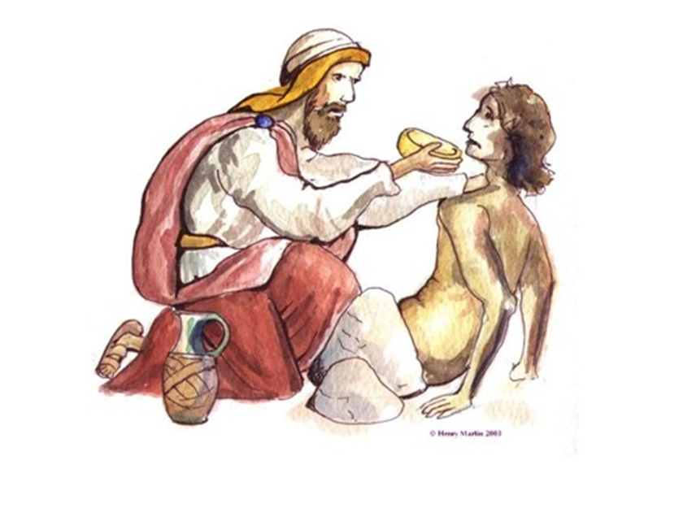
Why Christian Legal Aid?
“The righteous care about justice for the poor, but the wicked have no such concern.”
- Proverbs 29:7
“Defend the weak and the fatherless; uphold the cause of the poor and the oppressed. Rescue the weak and the needy; deliver them from the hand of the wicked.”
- Psalms 82: 3-4

Slide 4
Christian Legal Aid network

Slide 5
What is the CLA Helpline?
A way for us to provide assistance to low-income callers seeking legal help
A human connection with people who are oftentimes in deep emotional pain
An opportunity to spread God’s love and assurance with our brothers and sisters in need

Slide 6
What does the CLA Helpline do?
Gives referrals to first legal aid clinics based on geographic location.
Gives information about other related resources
Shares the Love of Christ.
Helpline callers should NOT provide legal advice.

Slide 7
What resources can I offer Helpline callers?
CLA clinics
Secular legal aid clinics
Legal resources (self-help) websites
Legal aid resources by subject areas
Other legal hotlines
State bar referral programs
Christian ministries
Secular nonprofit organizations
Government agencies

Slide 8
What do I say?
Be polite, respectful, and professional.
Hi! I am a volunteer with the Christian Legal Society. I’m not a lawyer (or I’m not licensed in your state) and we do not provide legal advice or services. We have this helpline to provide referrals to legal aid clinics and, if possible, provide other resources that may be of help to you.”
Show that you care. Be sympathetic, but also be natural, conversational.
Match your tone to the client. Your voice has to take the place of a face-to-face meeting.
Allow the caller to tell their story a little, and if appropriate, to vent their anger.
Often, just providing a listening ear is a big comfort, even if you aren’t able to provide help.
Sometimes callers will express their frustration and anger to you.
Don’t take it personally.

Slide 9
Helpline Tips
Don’t talk too quickly
Avoid terms the caller may not be familiar with, such as technical legal terms
Be sensitive.
Don’t get too deep or ask questions that are too personal.
If you have reason to believe the caller may be in danger from others, suggest that they call 911 or a shelter (e.g. a woman’s shelter)

Slide 10
Helpline Tips
Spiritual Advice
Feel free to share spiritual advice to the extent you and the client are comfortable.
Feel free to offer to pray with the client, but ask permission first. Ask, “Do you mind if I pray with you?”

Slide 11
This caller is taking FOREVER!
If a caller goes on too long, politely and tactfully stop them.
“I’m sorry, but since I’m not a lawyer and can’t provide legal help, I don’t need the full details of your situation. Can you tell me what is the specific help you’re looking for?”
“I’m sorry, but I can only talk for a few more minutes. Can you tell me (ask what info you need to help them)”
“Thank you for that background information. I don’t mean to cut you off, but can you tell me, what is the specific help you’re looking for?”

Slide 12
Guidelines and Policies
Confidentiality
Keep all caller information confidential.
Don’t share client names, contact info, or any personal info with anyone other than CLS staff.

Slide 13
Guidelines and Policies
Referrals to CLA clinics
When making referrals to CLA clinics in the CLS network, indicate:
“While the CLA clinics are in our network, they are independent and not formally affiliated with CLS. Generally the clinics are run by volunteer attorneys and do not provide full representation, but provide free legal consultation and only limited representation in certain circumstances.”

Slide 14
Guidelines and Policies
Referrals to other resources
When making referrals or providing resources (other than CLA clinics) use a disclaimer:
“We provide these resources [referrals to other organizations] simply for informational purposes. We have not worked with them, so we cannot vouch for their quality or reliability. Please be sure to research them on your own and evaluate using your judgment.”

Slide 15
Guidelines and Policies
Referrals to private attorneys
If it appears that the client might be able to afford a private attorney, you can direct them to the CLS Attorney Directory. Generally, do not provide referrals to specific attorneys. Instead, suggest the caller search for attorneys themselves (unless they don’t have Internet access or are unable to search themselves).
Be sure to indicate:
“The attorneys in the CLS Attorney Directory are private attorneys not affiliated with CLS, and generally do not provide pro bono services. You will have to find out from them how much they charge.”

Slide 16
Legal Information v. Legal Advice
If you are not a lawyer, it is not permissible for you to provide legal advice, even if you know the law.
Even if you are a lawyer, please do not offer legal advice to Helpline callers.
You may provide legal information, however, the line between legal information and legal advice is not always clear.
You should always preface your statements with the caveat that, “I am not an attorney, so I cannot give legal advice.”

Slide 17
Here are some general guidelines for drawing the line:
Legal Information | Legal Advice
(permissible to give) | (NOT permissible to give [unless licensed])
What the law says | What the law means.
General, hypothetical | Specific: application to specific facts & circumstances
Which forms are provided by the relevant court or government agency | What to put in the forms
State the court or agency procedures | Advising how to navigate procedures
Answers to questions: “Who can I call for help?” “Where can I find information about ___?” | Answers to questions: “What (legal) steps should I take?” “What do you recommend I do (legally)?”
Notes:
As someone who is not an attorney (or not licensed), do not say anything definitive such as, “In Texas, the criteria for determining child custody are . . .” Instead, you should always preface your statements with the caveat that, “I am not an attorney, so I cannot give any legal advice.” Then you may state something such as, “The website of [XYZ organization] states that in Texas, the criteria for determining child custody are . . . However, I cannot vouch for the reliability of this information. I recommend that you go to that website (or contact that organization) to research this issue yourself.”

Slide 18
Types of Clients Needing Special Attention
Assertive or aggressive clients
Talkers
Non-Talkers
Angry
Delusional
Diminished Capacity
Non-English Speaking
Hard of Hearing

Slide 19
Helpline Log
Upon completion of call, please fill in Helpline Log form at:
tinyurl.com/CLAhelplinelog

Slide 20
Google Voice
Google Voice provides a free phone number for calls, text messages, and voicemail. You can use this number to dial using your web browser and mobile devices.
https://voice.google.com

Slide 21
Other Helpful Resources
The Art of Active Listening
Tips For Answering a Crisis Hotline

Slide 22
Thank you!
Questions? Contact:
Ken Liu – Director, CLS Christian Legal Aid
kliu@clsnet.org 703-894-1086
Elizabeth Drake - Program Manager, CLS Christian Legal Aid
edrake@clsnet.org 703-835-9599
Valerie Clark Bolton – Chief Helpline Volunteer
Paralegal, Christian Legal Clinics of Philadelphia
vclarkbolton@clcphila.org (215) 422-4082 x102

